Slide 1
Visual and Textual Analysis
Using Python NLTK libraries for textual analysis

Slide 2
Background
We will be taking a look at Dr. Snow’s paper through visual and textual analysis to get an idea of where the book currently lies, and from a publishers perspective, what we can hope to change in regards to provide a better outcome as per the respective focus of the book.

Slide 3
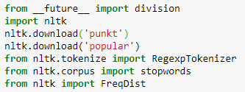
Imports
nltk is the library used for th text analysis
Tokenize regextokenizer used to convert the imported string into substrings
Corpus stopwords is a very usetool to filter out the useless data
Freqdist use to print the most frequent words

Slide 4
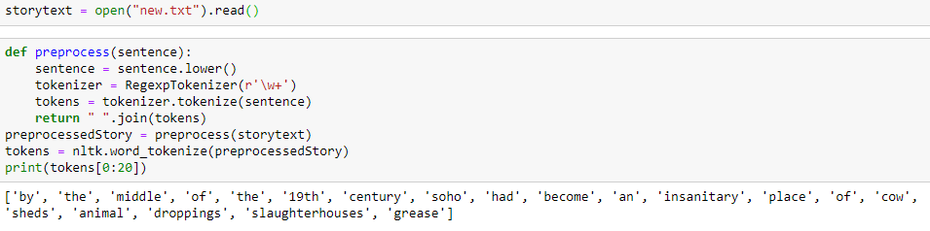
Preprocess Data
This is the function used to read the file and tokenize data.

Slide 5

Lexical Diversity
Our lexical diversity is around 16%
Lexical diversity is a good measure of how informative a text is
The story used is John Snow’s cholera
Calculation for lexical diversity is the number of unique words / len of words
Our first observation is the story may not be informative

Slide 6
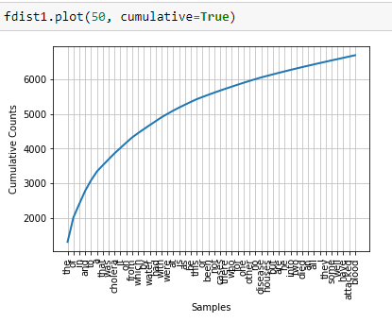
Distribution of Words
This is the distribution of words
This graph includes words that do not add value
To get better view of the distribution of word we will have to remove useless words

Slide 7
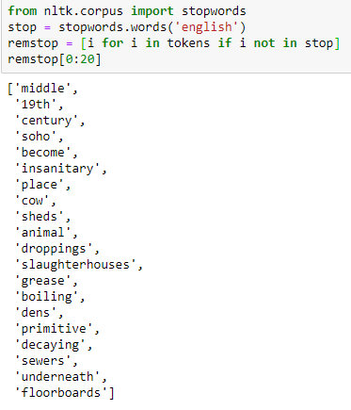

Removing Stopwords
A great way to get a better understand of the text is
to remove useless words also known as stopwords.
Removing stopwords allow for greater lexical
diversity

Slide 8
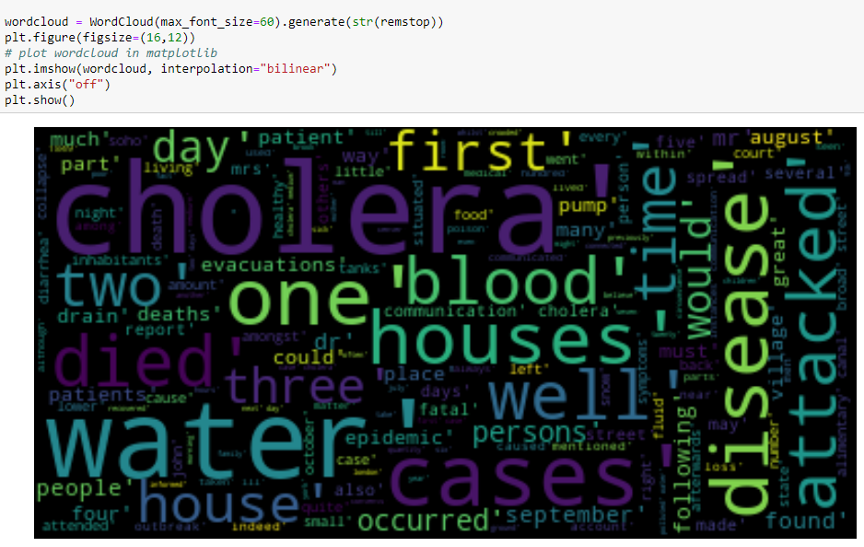
Word Cloud
The word cloud allows the reader to see clearly the most common words
The larger and bolder the word the more common it is
As you can see the word by removing the stop words the story the algorithm was able to create a diverse word cloud

Slide 9
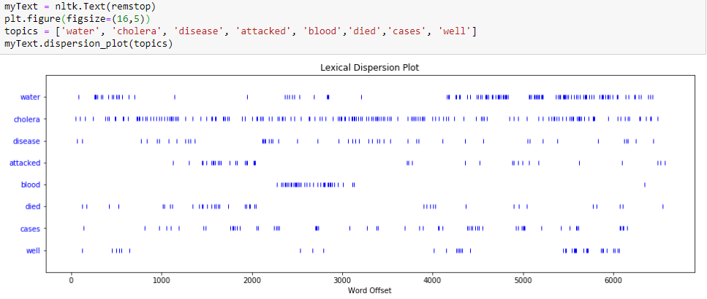
Dispersion Plot
The dispersion plot visualizes the importance of a word
It allows for the measure of the homogeneity of a word over the corpus
The word cholera is consistently used through the text
Water and disease is the other set of word that happen throughout most of the text.
It is expected since John Snow’s research was about find the source of the cholera outbreak

Slide 10

Sentiment Analysis
Sentiment analysis is a great way to determine the tone of the text
We can analyze John Snow’s words for understand his tone
NLTK Vader AI was used to give some insight on the text
The scale used is:

Slide 11
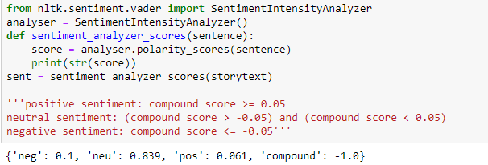
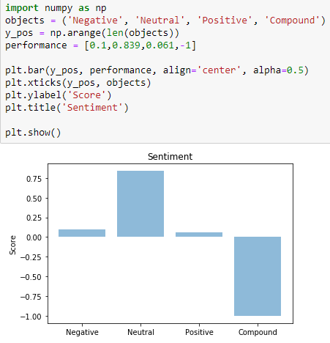
Sentiment Analysis
Our analysis found that there with a high negative sentiment
This was expected since the story is about Cholera
and the death surround it.

Slide 12
Conclusion and Editorial Suggestion
John Snow’s writing was not lexically diverse with stopwords
After removal of stop words we were able to increase diversity
A word cloud was used to show the prominence of words such as cholera, water, disease ,death,etc
A dispersion plot was use to present the parts of the text where certain words appear. Since Cholera was the topic, it was present throughout.
Lastly a sentiment analysis was used and was determined the text has a high negative sentiment
The final conclusion is John Snow was effective in conveying his findings from the analysis

